Slide 1
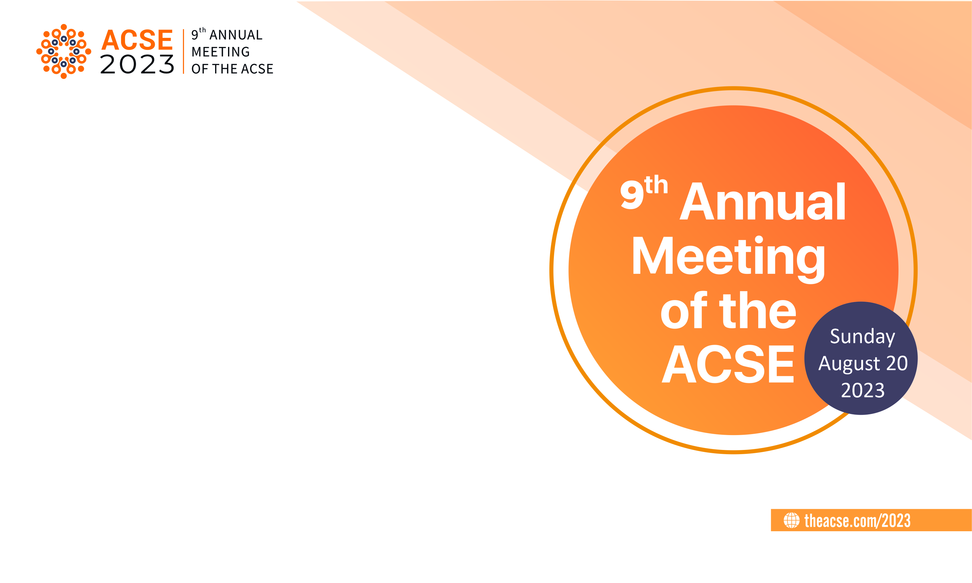
The human touch in publishing:
Why language editors are vital
for error-free, well-crafted
research papers
Gunjan Khashu
Chief Operating Officer
Accuracy, Dubai, United Arab Emirates

Slide 2
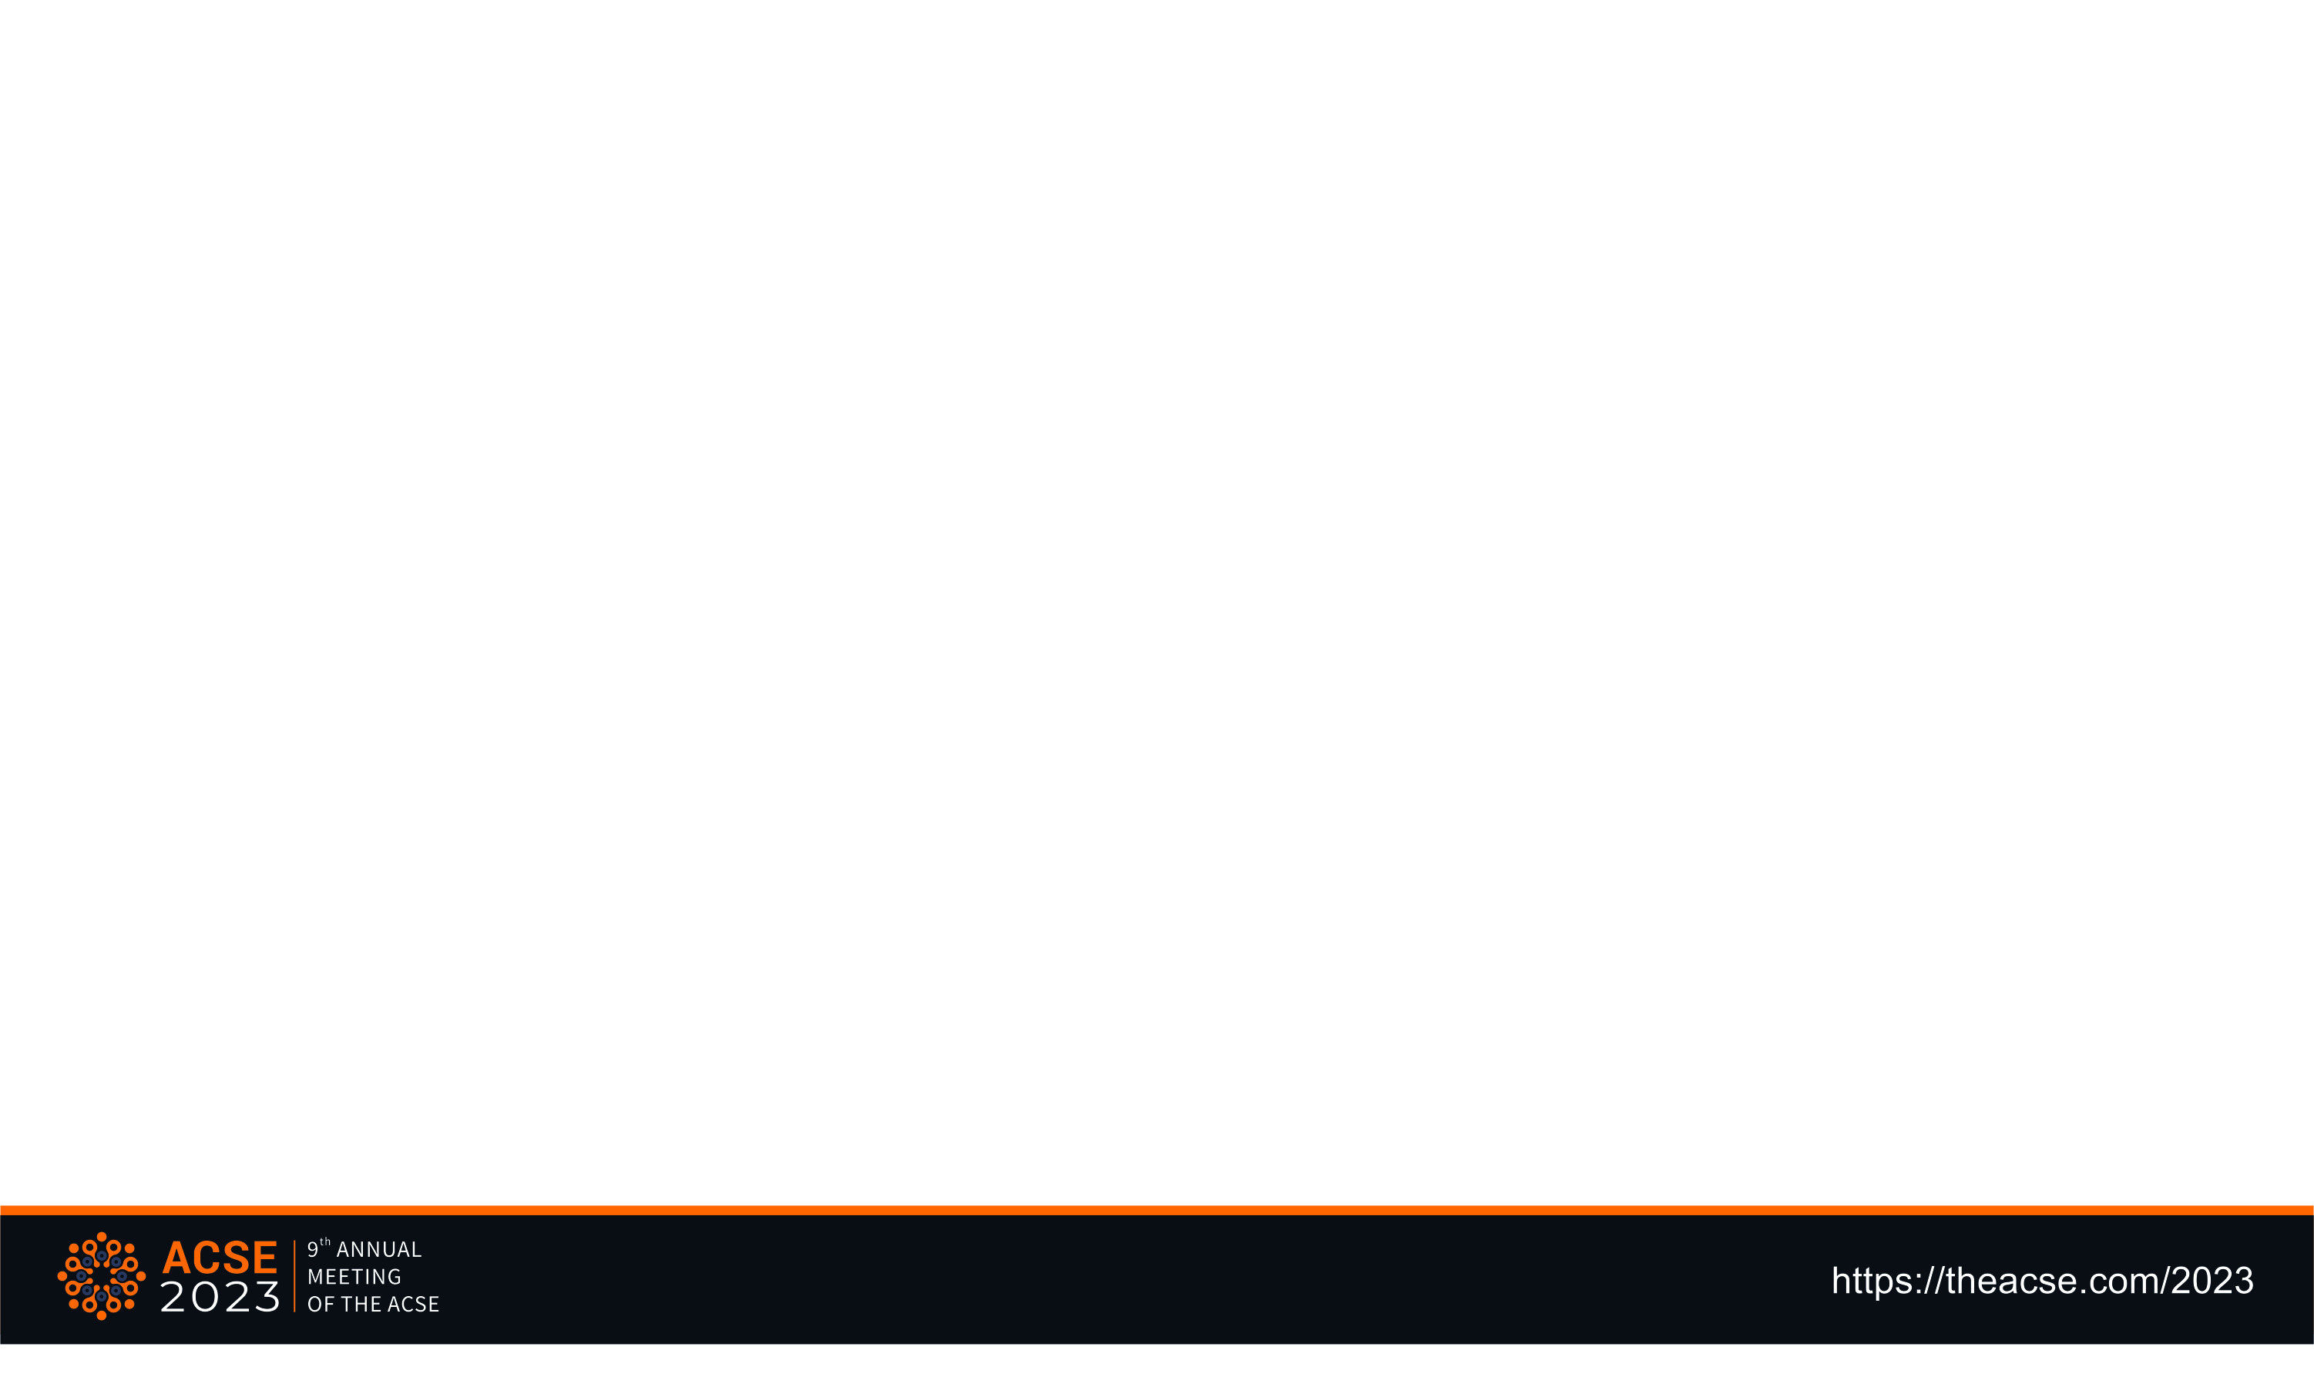
Opening comments
A bit about Accuracy and me
Why this topic?
Notes:
A bit about Accuracy and me.
Accuracy (https://proaccuracy.com) helps universities and research institutes improve their reputation and ranking by improving the chances of research articles getting published in well-reputed ISI-indexed international journals. Our editing services help scientific research gain visibility by helping it get published in authentic academic journals. Our experience in working with researchers and institutions in the GCC region and our motto of providing simplified language solutions has been responsible for our success. We offer various levels of editing services with proofreading as our basic offering and our Premium Editing service as the top-of-the-range offering. We are proud to have a team of seasoned professionals who can help researchers and authors vastly improve the quality of their written content.
My name is Gunjan Khashu and I am the COO and Founder of Accuracy. I have over 15 years of experience in the field and have previously worked in the Academic Editing and Publishing field with the industry leaders. I started this company in September 2022 because I am passionate about helping improve the quality of the written word especially for brilliant researchers and authors in the world for whom English is not necessarily their first language of preferred language of communication.
Why this topic?
Being in this industry in today’s world is tricky business. Especially because we, humane editors, are increasingly being pitched against AI-assisted tools that are churning out machine edited texts by the minute. Without further ado, I would like to share my two cents on the importance of the human touch in publishing.

Slide 3
Who Are We: A company founded by publishing experts and instructional designers with extensive experience in academic editing and designing unique learning experiences for academic institutes as well as corporates. With team members present in UAE, Australia, UK and India, we have a global presence.
Our Mission: To provide innovative language solutions that meet the evolving needs of our clients, while upholding the highest standards of accuracy, consistency and efficiency.
Our Vision: We aim to become world leaders in providing end-to-end language solutions, including content creation, editing, and localization, by combining human expertise and artificial intelligence.

Slide 4
Our core service offerings include…
  Premium Editing- Ideal for documents that need to be comprehensively edited for structure, organization, flow, language, grammar, and more
  Copy Editing-Ideal for documents that need to be thoroughly edited for language and grammatical accuracy
  Proofreading - Ideal for documents that need light editing for punctuation and style

Slide 5
WHY this topic…
Human intervention is creative intervention
An editor plays multiple roles; one of which is that of a fact-checker
An editor can and should help maintain the “academic voice” of the author(s)
Levels of editing and how humans do it best
AI-tools and textual complexity
AI-tools and the unreliability of data patterns, and the loophole of socially structured bias
Data security potentially at risk
Notes:
Human intervention is creative intervention
Human intervention is creative intervention. I guess what I want to highlight here is that God created Man and humans created AI. Never will Man be able to replace God and the same is true for the human-AI relationship.
When an Editor, a human, looks at a research paper, some of the things that we can always be confident about is a unique approach to looking at that paper, a creative outlook that is person specific and an eye for detail that has been honed with years of experience in the field. This, I can confidently say, is not true for an algorithm generated machine that takes its cue from realms and realms of data injected into it sans a creative and unique approach.
An editor plays multiple roles; one of which is that of a fact-checker
I know that AI is increasingly becoming smart enough to generate written content, correct grammar and punctuation errors and provide suggestions; however, relying entirely on an AI tool to help you edit your research is not foolproof. Although AI-assisted tools can help cut down the human effort for relatively mundane tasks such as rectifying forgotten commas, it would be along time from now, if at all, that we can rely 100% of AI to fact-check a document with precision. This is because an AI-tool might be an action tool where it can complete an action by following a command; however, expecting it to be a thinking tool where it can adequately assess content still requires the human touch. For example, I can safely say that only a human editor can adequately evaluate the quality of written content to be able to determine the best way to structure and format it to present it to the reader.
An editor can and should help maintain the “academic voice” of the author(s)
Every research paper is unique due to the unique “academic voice” of its author or authors. If all papers are edited using the same set of data points, chances are that the originality of the “academic voice” will be diluted or lost and all papers will start resembling each other in terms of writing and presentation styles. With a human editor, you seldom runs this risk.
Levels of editing and how humans do it best
I strongly believe and can say with confidence given my years of experience in the field that a human editor is capable of accurately and adequately editing any written content at various levels of depth. In the industry we tend to name these services as proofreading, copyediting and premium editing or extensive editing services. An AI tool can also do this. But as I have established above, AI tools can struggle with editing complex ideas and text.
AI-tools and textual complexity
At the risk of inviting varied options, I am going to open pandora’s box and use the example of the very popular Grammarly app. I read this online, “Grammarly is a grammar-checking tool available for Windows, Mac, Linux, Chrome, Firefox, Android, iOS, and almost every single platform out there. The tools allow you to write error-free documents with features that enrich your writing skills. It has an in-built dictionary, an autocorrect system, sentence rephrasing, and even plagiarism-checking functionalities. Grammarly is free to use, but a premium version is available for extended features.”
Well, so can I or any other language editor. However, a human editor has the upper hand in the case against Grammarly. Let me explain how.
At Accuracy, with our top-tier editing service called Premium Editing, any researcher can rest assured that their document is structured in a logical flow, is extremely readable and easy to understand, boasts pitch-perfect grammar, punctuation and spelling accuracy and is publishing ready. As the author, you have the choice of communicating with your editor at any point of time. However, this is not possible with a machine. The human touch helps researchers get the peace of mind that their paper is being read and edited by a thinking, living person.
AI-tools and the unreliability of data patterns, and the loophole of socially structured bias
I am open to opinions on this one. But first, may I please share mine. From what I have read, heard and understood, similar to humans, AI systems can also have inherent biases. These are of course due to knowledge and information that humans has input into them. Therefore, their output is molded by the data they are trained on. These biases may not immediately become evident; however, they are capable of well and truly swaying public views in subtle yet profound ways. Controlling this inherent bias may be difficult to detect before it is too late and equally challenging to control. However, given that the human mind is very capable of thinking and acting, we can control and curb such biases and also spot them at a much earlier stage.
Data security potentially at risk
I think we will all agree that cybersecurity threats are a real issue today. A potential threat that I foresee of using online tools data leakage. Although AI tools such as Grammarly promise data security, this is still a threat. Agreed that this might be a threat even with a human editor. However, I think we will all agree that human accountability is better managed than machine accountability.

Slide 6
Closing remarks
The future of original content
Questions…
Notes:
The future of original content
I would like to close my presentation with reiterating my points on how the human touch is vital for any research author to maintain their “academic voice”, and original thought and writing style. AN AI tool functioning with the same set of data points can eventually albeit involuntarily lead to duplication of writing style and data patterns. I think we will all agree that every research author wants their original thought and style to be reflected in their work. For this, a human editor is the best choice.
Questions…
Thank you for listening to me. I am open to questions, if any.

Slide 7
Thank you

